Slide 1

Distributed Computer Labs HTV Challenge 2
Designed by: Matthew Wong, Mitchell Liu, Sarah Li

Slide 2


Introductions
Matthew
2nd yr CS student at SFU
Data scientist pursuing fullstack SWE
Robotics Enthusiast
Mitchell
2nd yr CS student at SFU
Pursuing software development and happiness
Avid manga reader
Sarah
2nd yr mechatronics student at SFU
Pursuing product design and development
K-drama enjoyer

Slide 3

Purpose
Challenge:
Create an algorithm that would predict the total number of infections during the following 100 days
Businesswise:
Provide a tool for specifically healthcare workers and the public to accurately predict trends in daily COVID infection rates

Slide 4
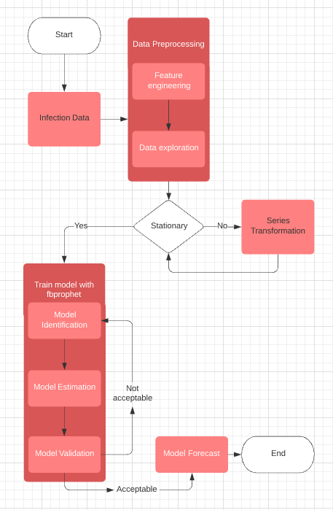
Workflow
Data preprocessing
Training model
Fit model

Slide 5
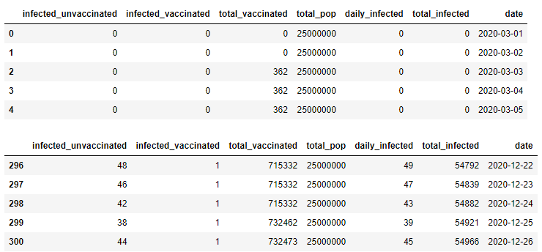
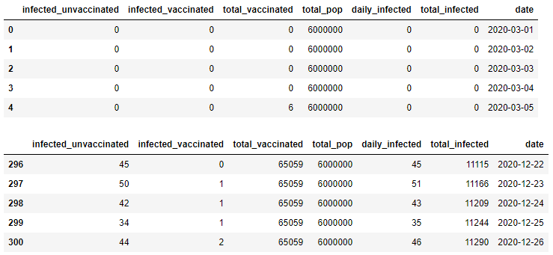
Data Preprocessing
Feature Engineering
Date
Needed a date since it’s a time series problem
Keeps track of number of days
Total_pop
Total population for each dataframe
Daily_infected
The infected_vaccinated + infected_unvaccinated
Total_infected
The daily_infected + the previous total_infected
Used the provided csv files, observation 1, 2, 3

Slide 6
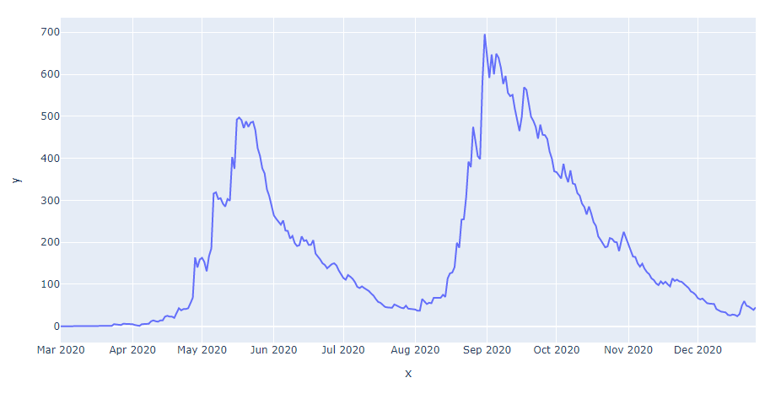
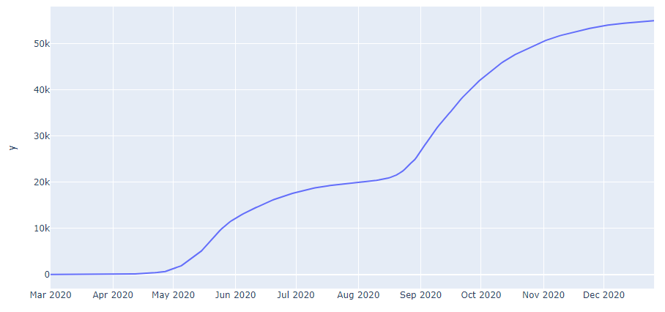
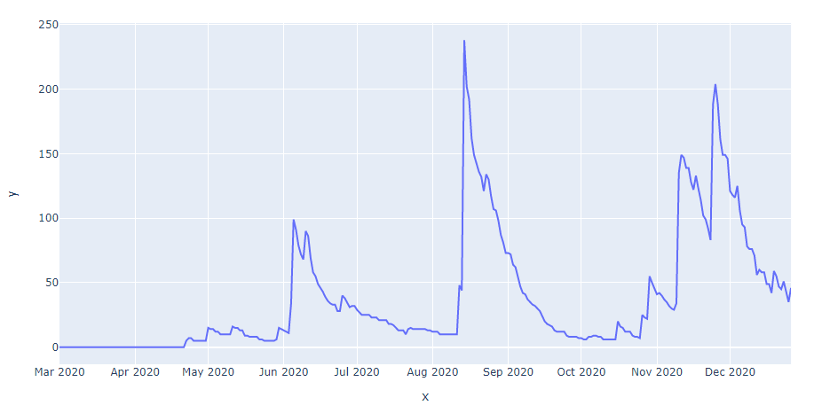
Data Preprocessing
Data exploration
Graphed the daily infections vs the date for each dataframe
Check if the data is stationary
Look for seasonalities
Graphed the total infections vs the date for each dataframe
See how sharp or flat the spikes are overtime

Slide 7

Model Building
Modeling - time series
Used fbprophet to model
High accuracy base model
Easy to implement
Wide variety of hyperparameters that can be used to finetune the model
Extremely robust model
Runs super fast

Slide 8
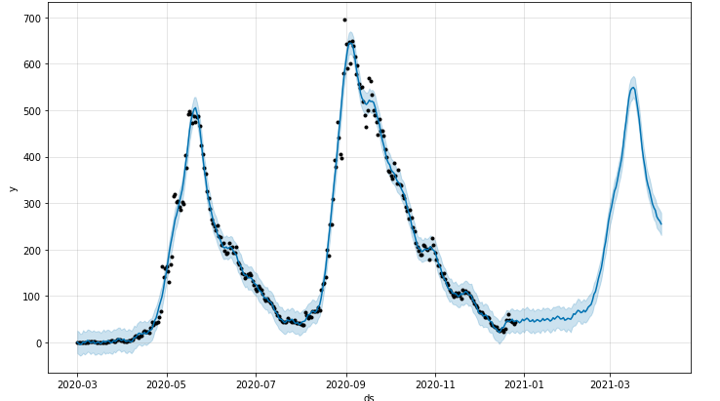
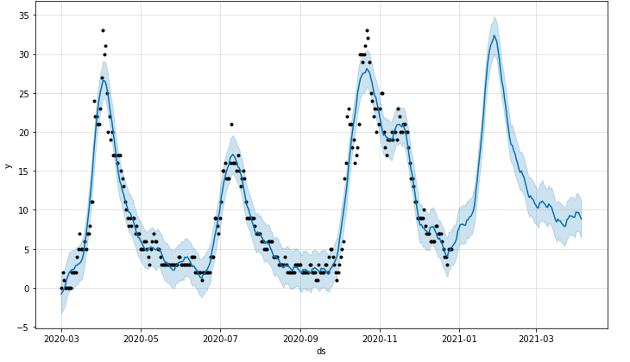
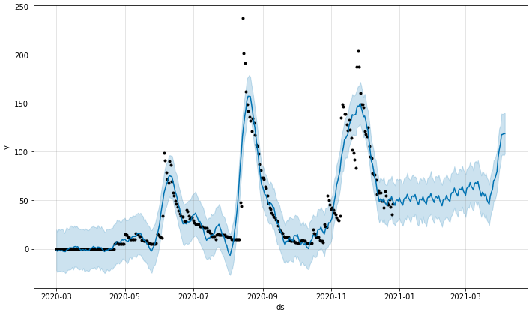
Model Evaluation
Observation 1
Observation 3
Observation 2
Evaluated the model using mean squared error
The stark contrast in MSE’s can be attributed to the size of the populations in each observation
Observation 1 | Observation 2 | Observation 3
MSE: 358.2 | MSE: 275.1 | MSE: 3.6

Slide 9
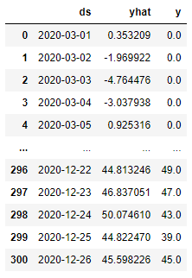
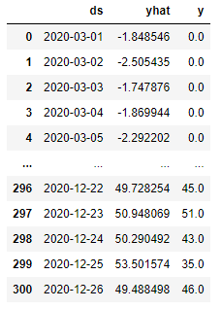
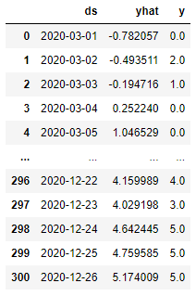
Model Evaluation
Observation 1
Observation 2
Observation 3

Slide 10

Challenges
What could’ve gone better?
Set floors when modeling to prevent the prediction from being less than 0
Taken more time to finetune the parameters to reduce the MSE, especially when predicting with observation 1 and 2
Normalised dataset (use log transformations or shifting down) to increase accuracy and help with overfitting

Slide 11



Moving forward
Where could this project go?
Code is flexible and can be easily changed
We can apply the changes suggested previously
Apply it to not only COVID cases but can try it with different diseases as well
Common cold, malaria, etc
Apply location and geomapping to better understand WHERE the outbreaks happen and how it spreads
What’s next for our team?
Two of us have very little coding experience and we’re all new to the MLH/hackathon scene
Applying to more hackathons
Going to be at WesternHacks in November!

